Slide 1
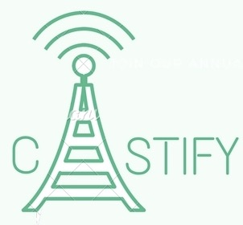
Software Defined Radio using Raspberry Pi
-Aman Asrani
-Rishabh Khot
-Vipul Koul
Group 1, B.E. Computer Engineering

Slide 2
What is Software Defined Radio?
Refers to a technique in which all the signal processing is done in software.
The processing mentioned include mixing, filtering, demodulation etc.
The software can be used to implement different demodulation schemes and different
standards can be implemented in the same device.
The software can be updated so the device doesn’t become obsolete with time.

Slide 3
SDR vs Traditional Radio
Traditional radio chips are hard-wired to communicate using one specific protocol.
In contrast, software-defined radio hardware works with raw electromagnetic signals,
relying on software to implement specific applications.
The most obvious benefit is that instead of having to build extra circuitry to handle
different types of radio signals, you can just load an appropriate program.
Traditional Radio has not changed in over a 100 years. Software-defined radio will
make it possible to use the electromagnetic spectrum in fundamentally new ways.
Software is increasingly replacing hardware due to its cost effectiveness and scalability!

Slide 4
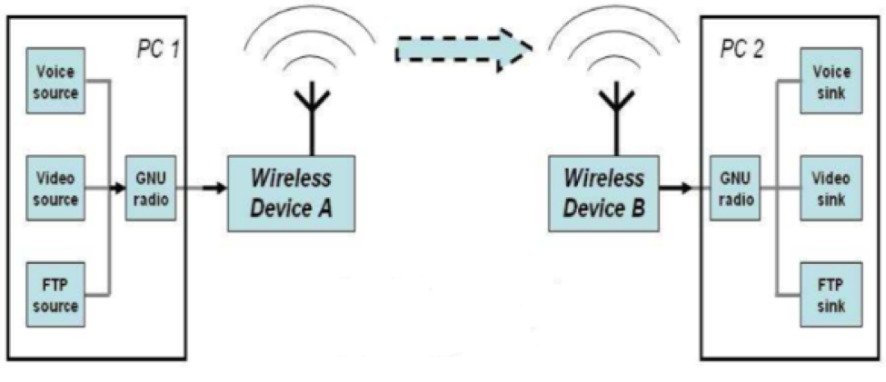
SDR Architecture

Slide 5
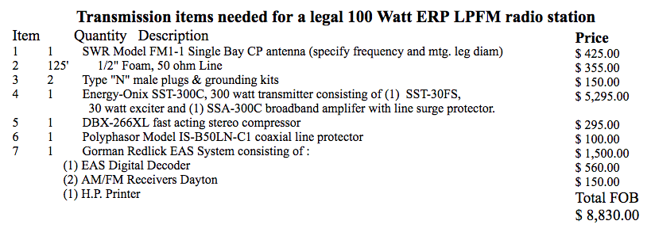
Cost for building Traditional Radio Transmitter
Total Cost: 5,91,610 INR

Slide 6
Existing SDR hardware
Military grade SDRs cost 7,00,000 INR onwards
Ettus USRP 4,50,000 INR onwards
Funcubedongle pro 10,000 INR onwards (No transmission capability)

Slide 7
Cost for our project: Castify
Raspberry Pi 35$ ( 2300 INR )
Copper Wire 2$ ( 130 INR/ per meter)/ Optional Dipole Antenna under 250 INR
Power adaptor for raspberry pi ( optional: can be powered from laptop.) 299 INR
Total Cost: 2,849 INR

Slide 8
Why Raspberry Pi?
Low cost
Credit-card Sized
Minimal Power Consumption

Slide 9
How does it work?
Raspberry Pi
It uses the hardware on the raspberry pi that is actually meant to generate
spread-spectrum clock signals on the GPIO pins to output FM Radio energy.
Raspberry Pi has clock generators, that can output square wave to the GPIO pins.
If you program clock generator to the desired frequency you'll get the signal,
and when you change the frequency, the signal becomes a frequency modulated (FM) radio.
GNU Radio
GNU Radio is a free software development toolkit that provides signal processing blocks to implement software-defined radios and signal-processing systems.
SoX -Sound eXchange, the Swiss Army knife of audio manipulation
SoX is a command-line audio processing tool, particularly suited to making quick, simple edits and to batch processing.

Slide 10
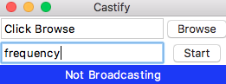
The GUI

Slide 11
The Setup

Slide 12
New Implemented Features
Change frequency
Designed GUI
Better broadcasting of signals

Slide 13
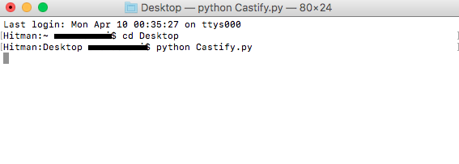
Steps of operation
Step 1:

Slide 14
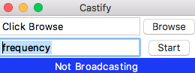
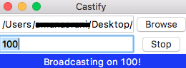
Steps of operation
Step 2:

Slide 15
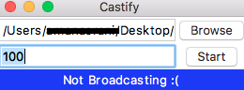
Steps of operation
Step 3:

Slide 16

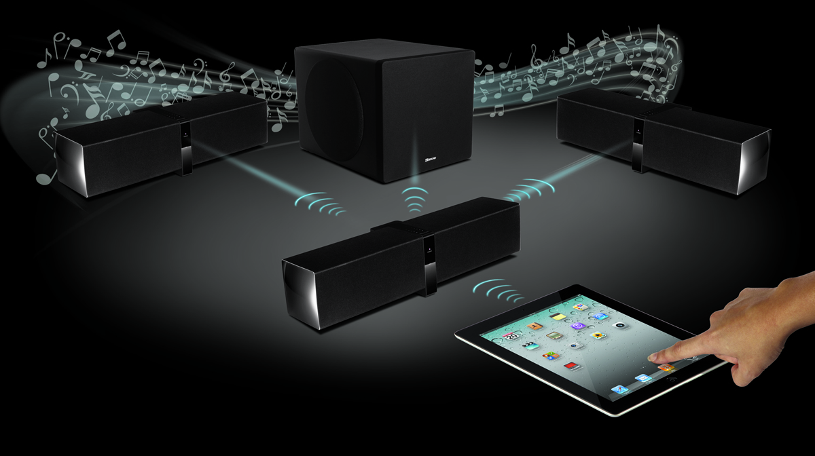
The Applications
1. Broadcast content on your own private radio station.

Slide 17
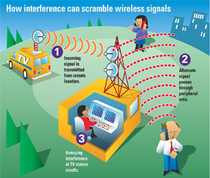
Cognitive Radio
A Cognitive Radio is defined as a radio which is aware of its surrounding frequencies and adapts/changes according to it.
This process is also known as dynamic spectrum management.

Slide 18
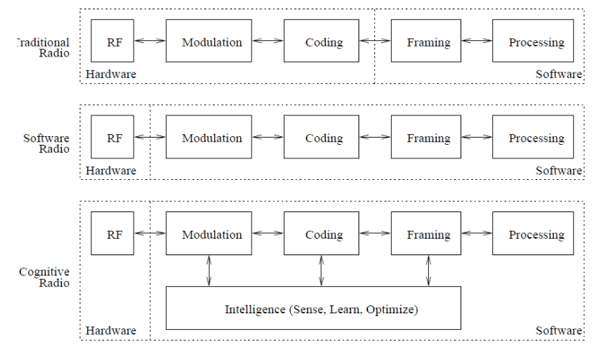
Cognitive Radio

Slide 19
Why Cognitive Radio?
Mobile devices are dealing with an increasingly complicated wireless environment.
In some heavily used frequencies, signal interference is a problem.
Government regulations also limit the frequency bands and communications technologies that radios can use, and other aspects of wireless transmissions.
Using one device — rather than multiple ones — to meet all these needs is more economical.

Slide 20
Why Cognitive Radio?
Mobile devices are dealing with an increasingly complicated wireless environment.
In some heavily used frequencies, signal interference is a problem.
Government regulations also limit the frequency bands and communications technologies that radios can use, and other aspects of wireless transmissions.
Using one device — rather than multiple ones — to meet all these needs is more economical.

Slide 21
Why Cognitive Radio?
Moreover, it is highly efficient to use a single device that can adapt in the middle of a communications session or work with radios that use different technologies when necessary.
This would help military and emergency-services agencies, which don’t all use the same wireless technology.
CR is a way to address these challenges.

Slide 22
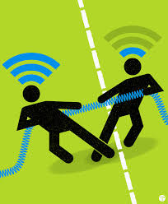
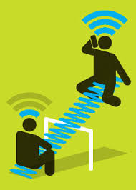

Why Cognitive Radio?
What we aim to achieve with Cognitive Radio

Slide 23
Future Scope
Femtocells and cellular agility
Cellular operators — including AT&T, China Unicom, Sprint, Verizon, and Vodafone —
have deployed or plan to deploy Femtocells (a Femtocells is a small, low-power cellular base station)
to homes and businesses to improve cellular and data communications’ speed and coverage.
The proliferation of Femtocells and the signals they transmit can create interference
and thus spectrum-usage problems.
Service providers and equipment makers are now looking at ways CR technology
could improve Femtocells operations by providing the intelligence that would let them reduce
interference with and from other devices.

Slide 24
Future Scope
Invent the wireless future!
Tools such as GNU Radio Companion when combined with low cost wideband SDR hardware make it easier, faster and increasingly affordable to prototype next generation wireless applications.

Slide 25
Challenges
The biggest barrier Castify faces in reaching its potential is changing the way businesses and regulators think about spectrum.
2. A big challenge is proving the technology's benefits in terms of increased reliability and resource utilization, better response time, and reduced operational expenditures to the managers who would decide whether to buy our equipment.
3. Needs more research on making the systems intelligent enough to improve the aggregate throughput.

Slide 26
References
[1] J. F. Curtis, (Ed.), Processes and Disorders of Human Comm-unication. New York: Harper and Row, 1978.
Journal Paper,
[2] Boonyarit Uengtrakul, Dahmmaet Bunnjaweht”A Cost Efficient Software Defined Radio
Receiver for Demonstrating Concepts in Communication and Signal Processing using Python and RTL-SDR “
[5] Introduction to Software-defined Radio approach ieeexplore.ieee.org/document/6142453/
[6] Cognitive Radio Communication’s in Raspberry Pi IEEE International Journal of
Engineering & Technology Innovations, Vol. 2 Issue 1, January 2015
Website,
[3] https://www.maketecheasier.com/run-radio-station-with-raspberry-pi/
[4] http://makezine.com/projects/pirate-radio-throwies/

